Slide 1

Nalaiyathiran
Team Id:PNT2022TMID13271
College Name : P.S.R. Engineering College, Sivakasi

Slide 2
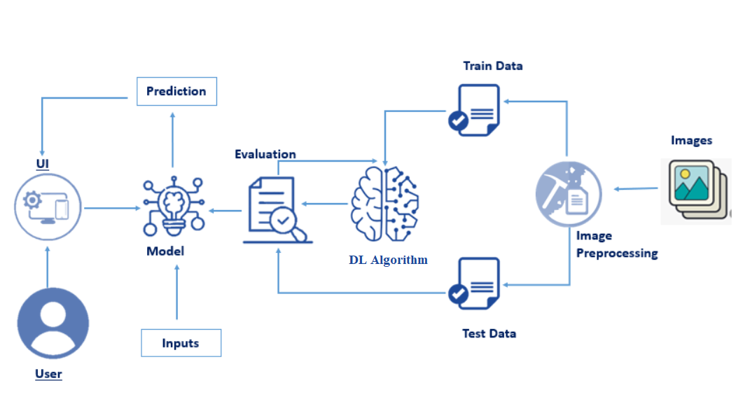
TECHNOLOGY ARCHITECTURE

Slide 3
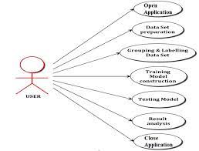
DATA FLOW DIAGRAM

Slide 4
TEAM LEAD M.JEEVAMUKESH (951919CS032)
TEAM MEMBERS
A.ARAVINTH (951919CS011)
M.KALIMUTHU MADASAMY (951919CS035)
V.MUTHUKUMAR (951919CS059)
M.MUTHURAJ (951919CS060)

Slide 5
THANK YOU

